Slide 1
Editor Scripting
Advanced Unity

Slide 2
Disclaimer:
Classic Editor vs UI Toolkit!

Slide 3
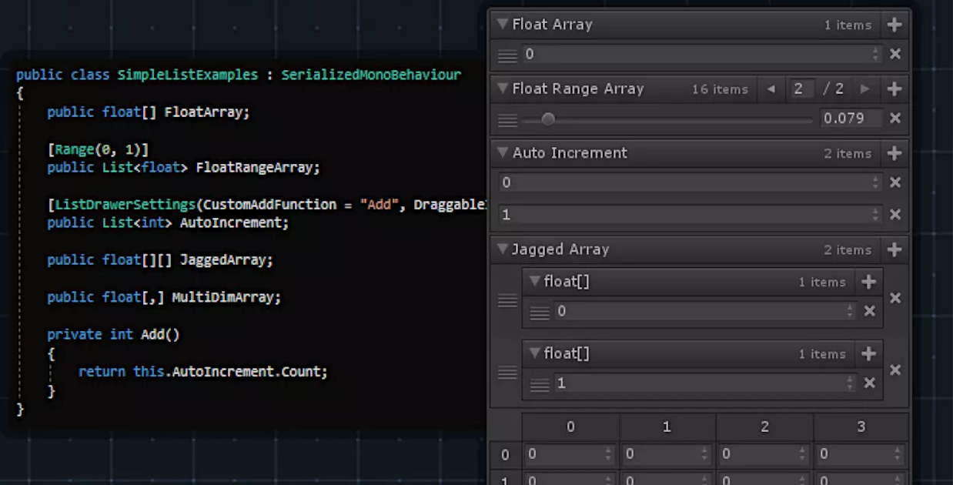
Content
Why we need Editor Scripts?
Editor Scripts keywords and structure
Attributes
OnInspectorGUI and DrawDefaultInspector
GUILayout & EditorGUILayout
Trigger methods from EditorWindow
Editor Folder
Editor Extensions
Gizmos
Custom Attributes

Slide 4
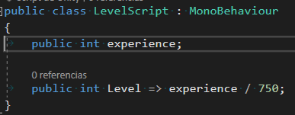
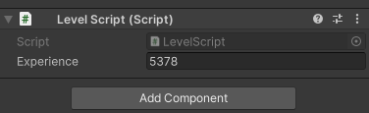
Why we need Editor Scripts?

Slide 5
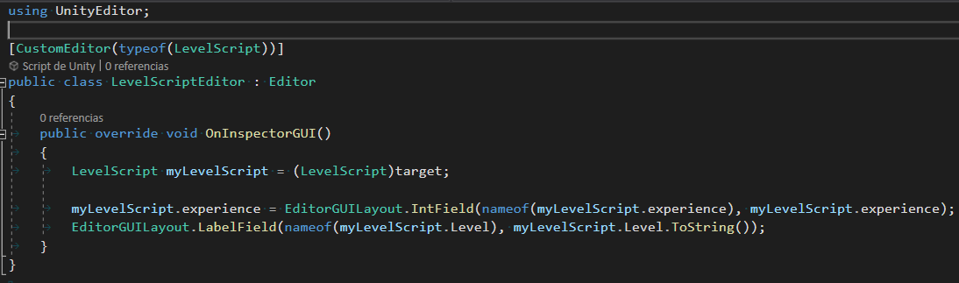
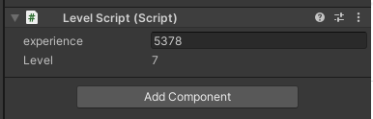
Why we need Editor Scripts?

Slide 6
Editor Scripts keywords and structure
Attributes
Inherit from Editor
Reflection/Compilation Time Code
Le what?!

Slide 7
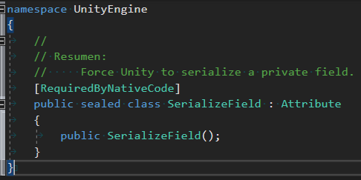
Attributes
Is this familiar to you?

Slide 8
Attributes
They are metadata markers to indicate special behaviours
They work with Reflection
Attributes are not a Unity thing, but a C# thing
But some of them are Unity-exclusive like [HideInInspector]
There are a bunch of them:

Slide 9
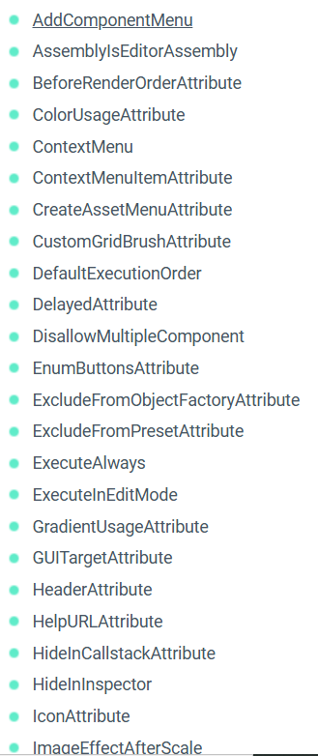
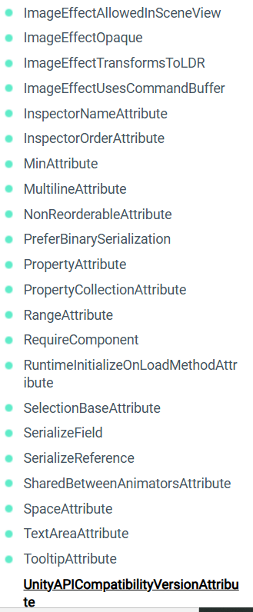
Attributes
https://docs.unity3d.com/ScriptReference/AddComponentMenu.html

Slide 10
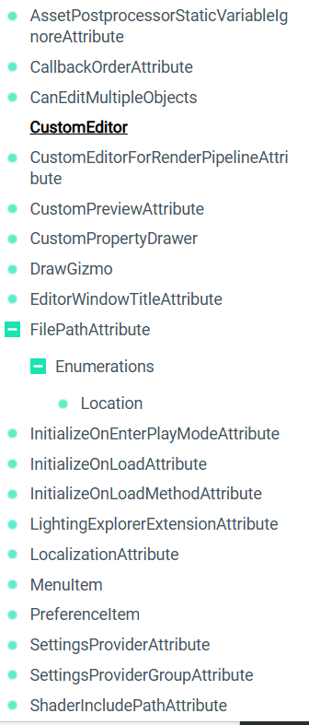
Attributes - Editor Exclusive
https://docs.unity3d.com/ScriptReference/CustomEditor.html

Slide 11
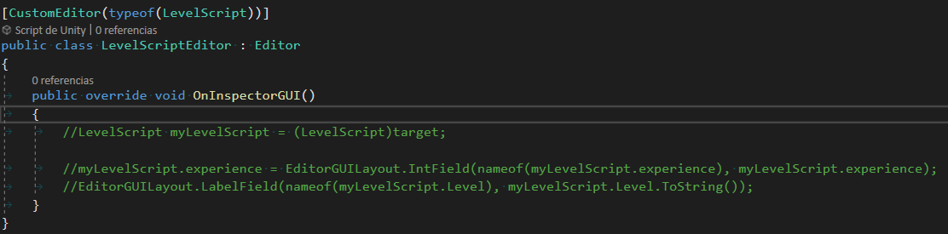

OnInspectorGUI and DrawDefaultInspector

Slide 12
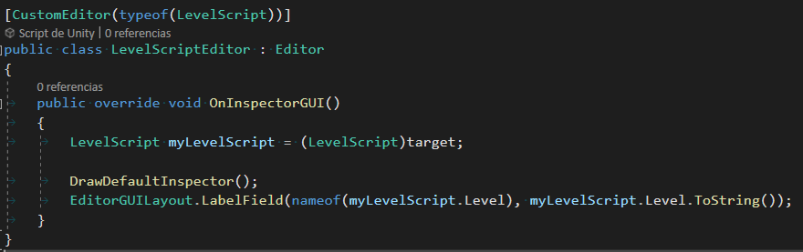
OnInspectorGUI and DrawDefaultInspector

Slide 13
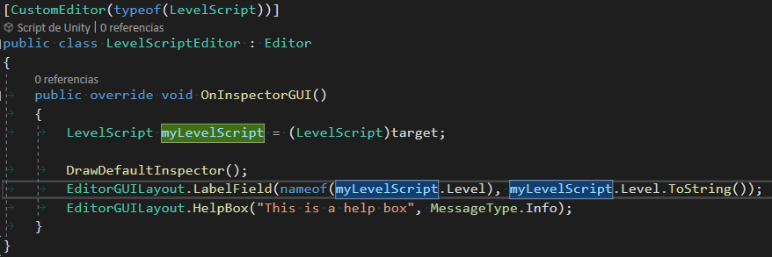
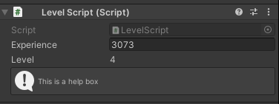
GUILayout & EditorGUILayout
Components already stylized for building Editor scripts “UI”
https://docs.unity3d.com/ScriptReference/EditorGUILayout.html
https://docs.unity3d.com/ScriptReference/GUILayout.html

Slide 14
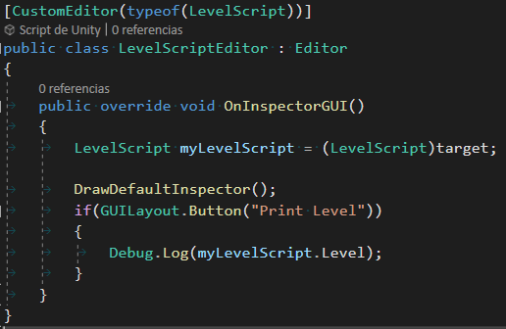
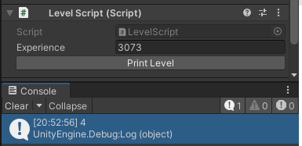
Trigger methods from Editor window
Usually we use Buttons for this
Keep in mind that the behaviour runs in Editor Time, like if our script have [ExecuteInEditMode] attribute.

Slide 15

Editor Folder
Editor scripts aren’t available in builds at runtime.
Scripts in an Editor folder run as Editor scripts, not runtime scripts.
You can have multiple Editor folders placed anywhere inside the Assets folder.
Even subfolders.
Use the EditorGUIUtility.Load function in Editor scripts to load Assets from a Resources folder within an Editor folder.
These Assets are only loaded through Editor scripts and are stripped from builds.
Unity doesn’t allow components derived from MonoBehaviour to be assigned to GameObjects if the scripts are in the Editor folder.

Slide 16
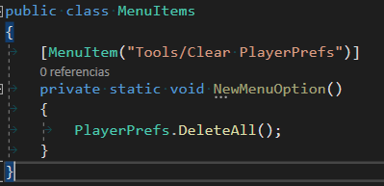

Editor Extensions
Unity editor allows adding custom menus that look and behave like the built-in menus.

Slide 17
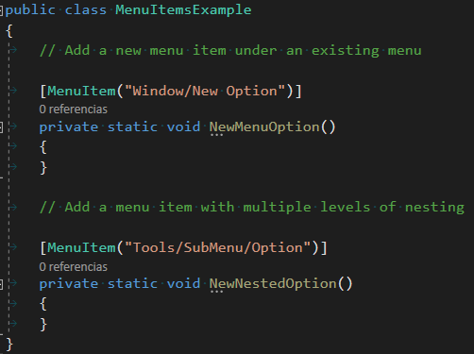
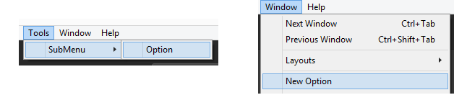
Editor Extensions
It’s possible to nest them

Slide 18
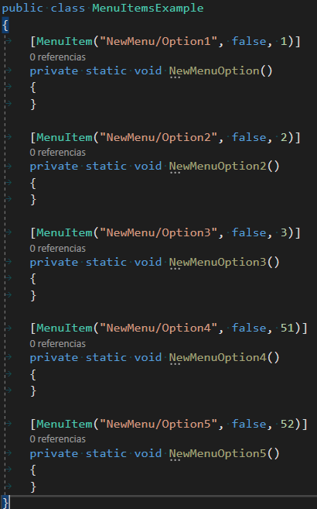
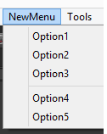
Editor Extensions
Priority Order

Slide 19
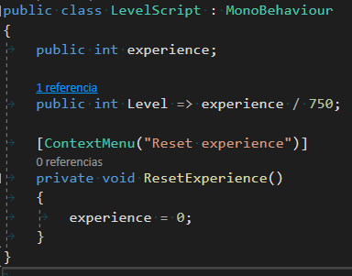
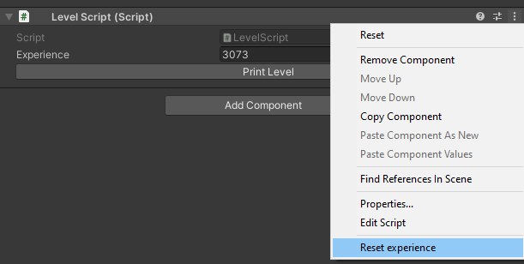
Editor Extensions
ContextMenu

Slide 20
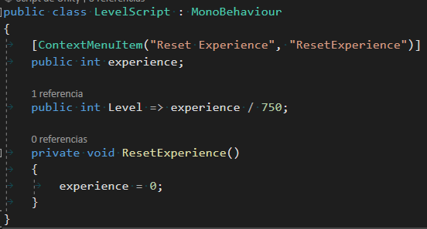
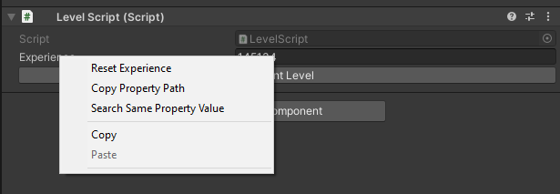
Editor Extensions
ContextMenuItem

Slide 21
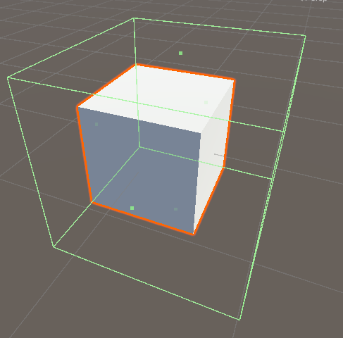
Gizmos
Did you ever tried to edit the rigidbody of an object?
How is this editable and visual, but not seen in Runtime?
Because it’s a Gizmo!

Slide 22
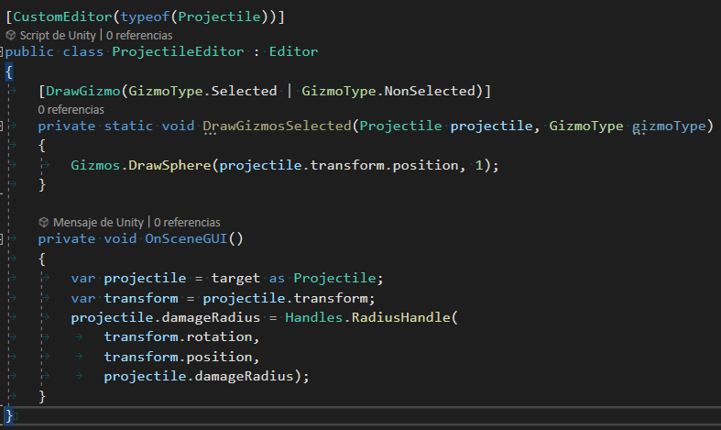
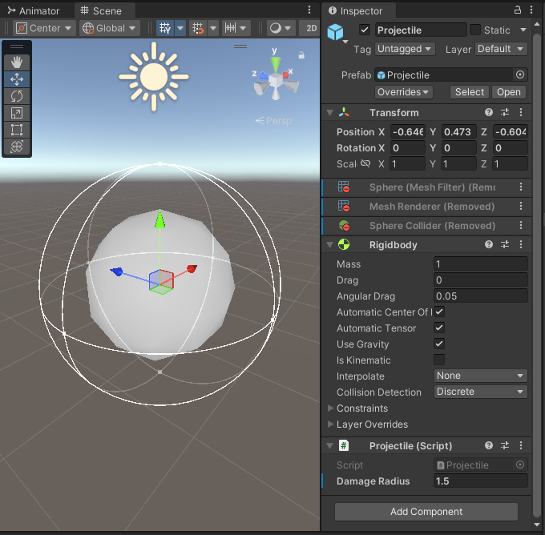
Gizmos
This can also be done by implementing OnDrawGizmos and OnDrawGizmosSelected in the Projectile class itself, however it is better practice to keep editor functionality separated from game functionality when possible, so we use the DrawGizmo attribute instead.

Slide 23
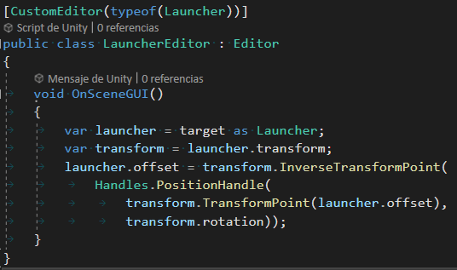
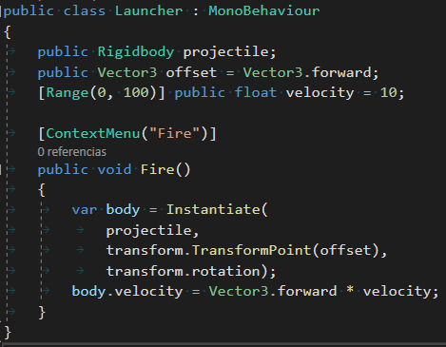
Gizmos
3
4
8
1
2
6
7

Slide 24
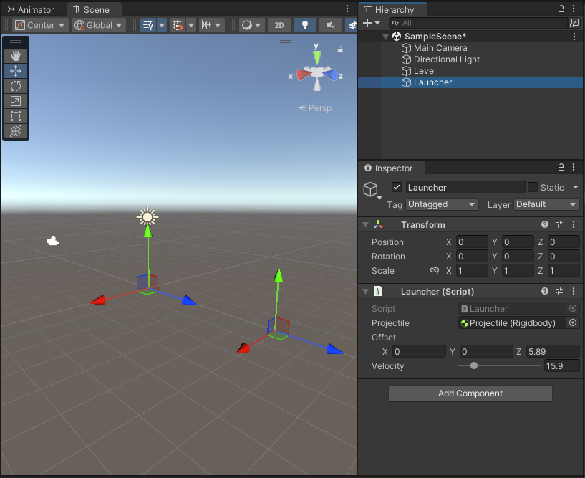
Gizmos

Slide 25
Let’s create our
Custom Attributes!

Slide 26
Custom Attributes
Property Attribute
Property Drawer
Decorator Drawer

Slide 27


Property Drawer - [DisplayWithoutEdit]

Slide 28
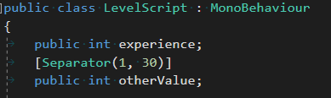
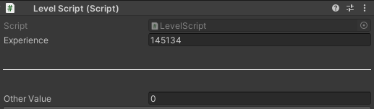
Decorator Drawer - [SeparatorAttribute]

Slide 29
Best Editor Extensions (in my experience)
Naughty Attributes
https://github.com/dbrizov/NaughtyAttributes
Free
Easy to integrate
Lack of some functionalities (like buttons with parameters)
Alchemy
https://github.com/AnnulusGames/Alchemy
Free
Requires Serialization Extensions and Unity 2021.2+
My preferred choice
Odin
https://www.odininspector.com/
Paid
The very best
Has some license limitations that you should be aware of

Slide 30
More Things to do if there’s enough time
Custom icons
Images on Editor
Editor Windows
Extend Unity’s Toolbar
Unity’s UI Toolkit
Notes:
https://www.youtube.com/watch?v=BMrYv9nNQGI&list=PLNoRsahkiuzV_OgO9QmIuCy7nr__RGzBS
https://learn.unity.com/tutorial/editor-scripting#5c7f8528edbc2a002053b5f9
https://www.youtube.com/watch?v=mTjYA3gC1hA

